Slide 1

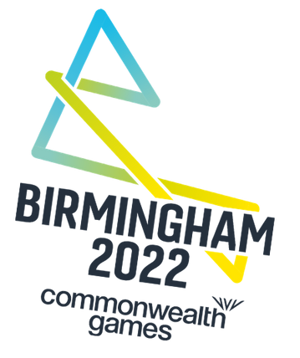

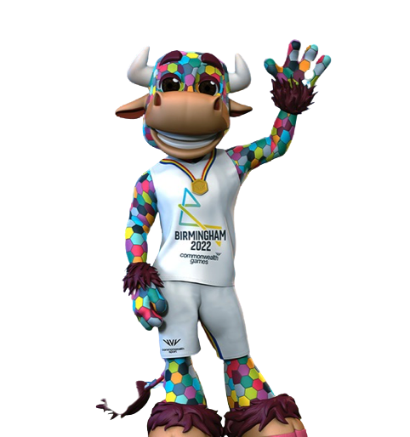

The Commonwealth Games
www.thepehub.co.uk

Slide 2


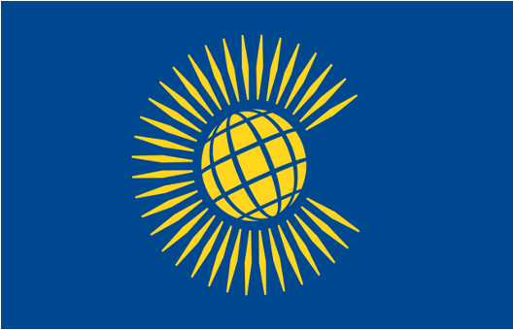
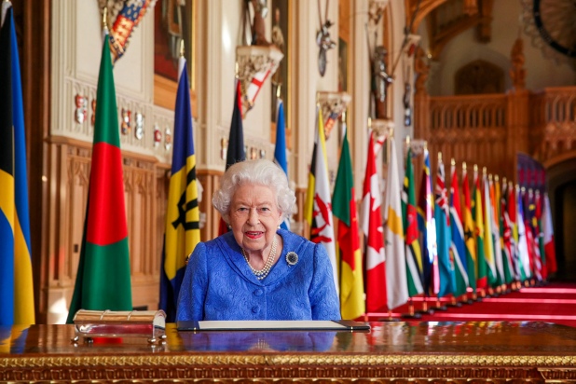

What is the
Commonwealth?
The Commonwealth is a political group of 52 countries that used to be part of the British Empire.
The British Empire was when countries were taken under British rule from the late 16th century through to 1997.
These countries are connected through their use of the English language that comes from being part of the British Empire.
The leader of the Commonwealth is Queen Elizabeth II of Great Britain.
www.thepehub.co.uk

Slide 3
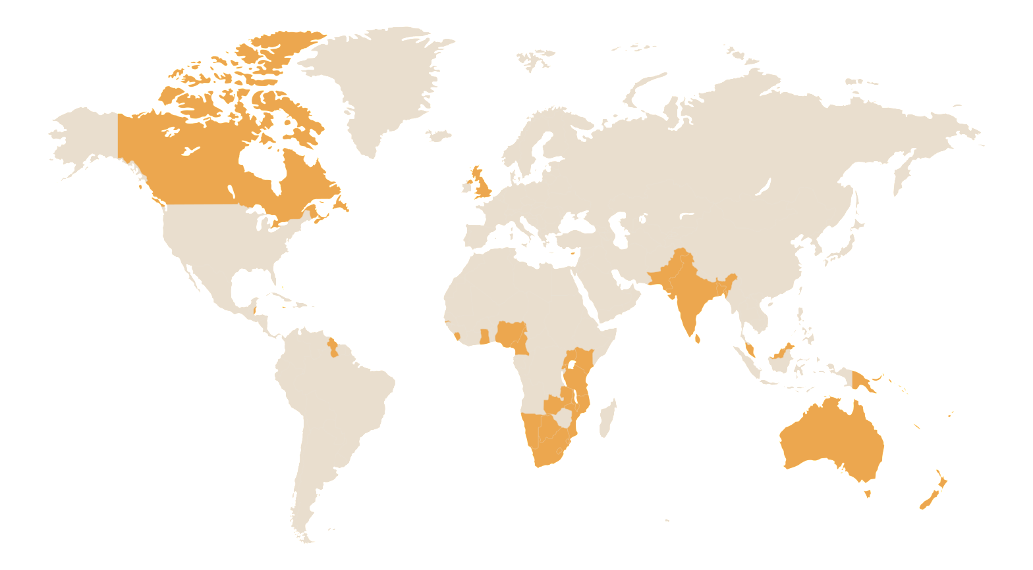

Countries of the Commonwealth
There are expected to be 72 countries and territories participating in the Commonwealth Games.
This is because unlike in the Olympics, England, Northern Ireland, Scotland and Wales compete as separate countries and not as Team GB.
These countries are from every continent (except Antarctica!).
www.thepehub.co.uk

Slide 4
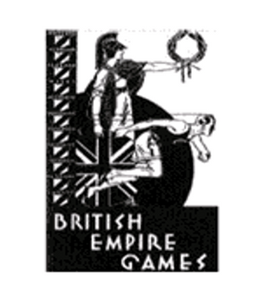

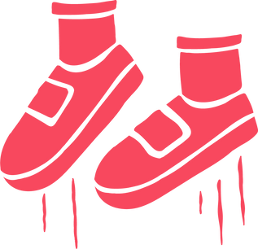

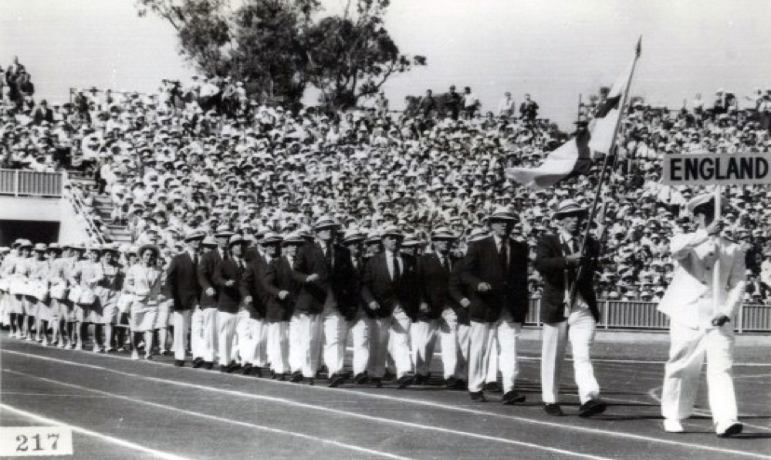
The First Games
11 countries competed over 6 different sports.
Women were only permitted to compete in aquatic events.
The competition lasted a week with England claiming the most Golden medals with 25.
The first games took place in 1930 in Hamilton, Canada.
They were known as the British Empire Games.
www.thepehub.co.uk

Slide 5

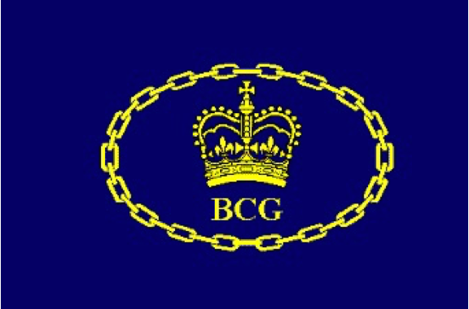


From the British Empire Games to the Commonwealth Games
After the success of the first games, the event was held every 4 years, except for in 1942 and 1946 due to World War II.
The number of countries and events involved increased over time.
The name of the competition changed over time to reflect the decline of the British Empire.
1930 – 1950 British Empire Games
1954 – 1966 British Empire and Commonwealth Games
1970 – 1974 British Commonwealth Games
1978 – Present Day Commonwealth Games
www.thepehub.co.uk

Slide 6




Sports
The first games had only 6 sports.
The 2022 is due to have 19 sports.
These include Olympic event such as cycling, athletics and swimming.
It also includes events not seen at the Olympics like netball, cricket and squash.
www.thepehub.co.uk

Slide 7


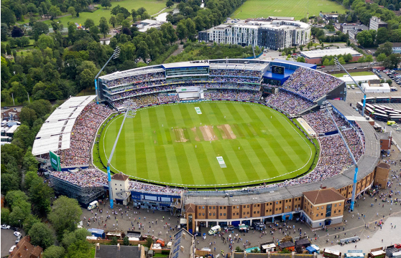
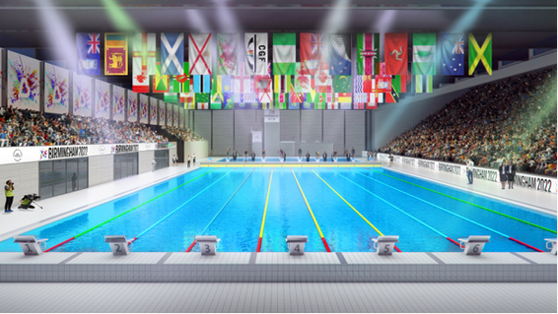
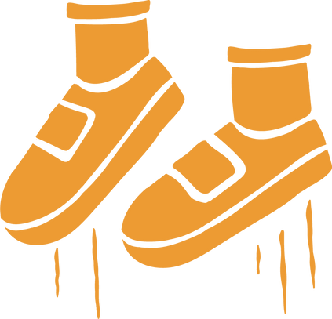
The 2022 Birmingham Games
These include Edgbaston Cricket Ground, Alexander Stadium, Sandwell Aquatics Centre among many others.
The games mascot is Perry, named after the famous Perry Barr of Birmingham.
This year's games are being held in Birmingham, UK.
They take place 28th July – 8th August.
Numerous venues across Birmingham are being used for the games.
www.thepehub.co.uk

